Slide 1
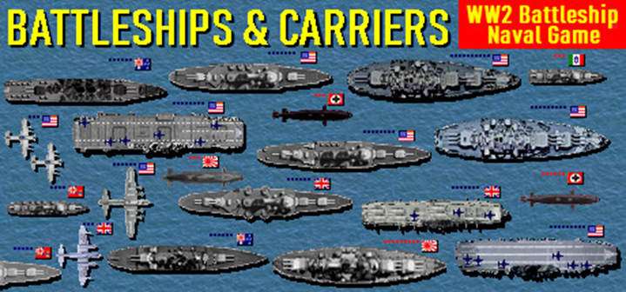
Battleships
BY Alex Melhuish

Slide 2
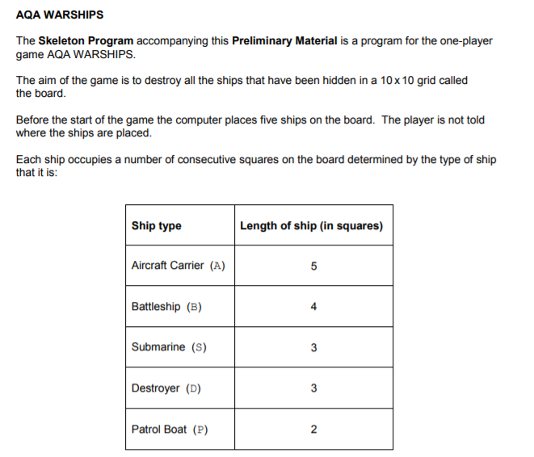

Slide 3
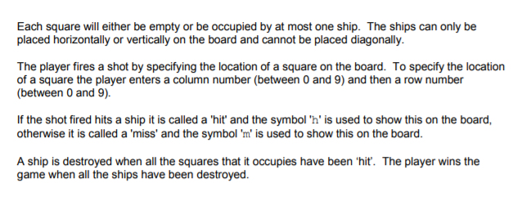

Slide 4
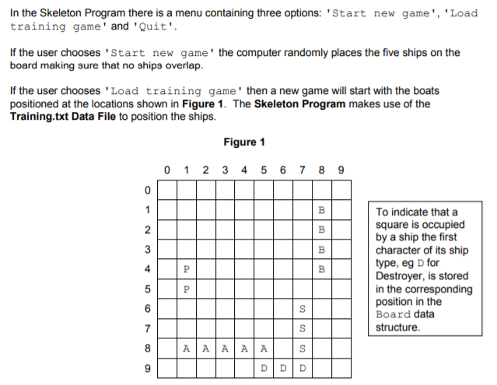

Slide 5
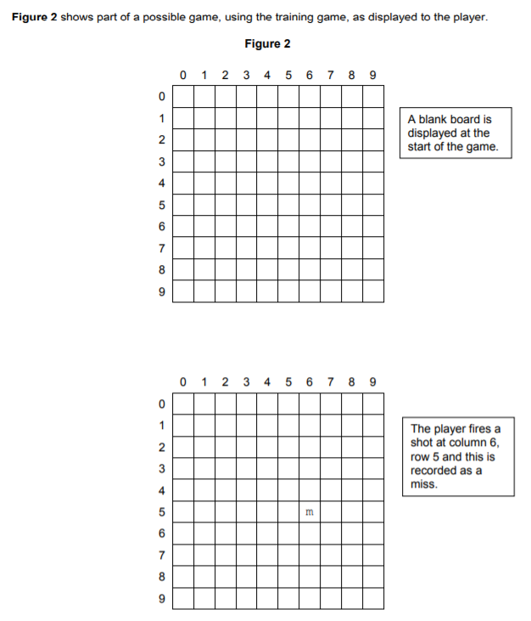

Slide 6
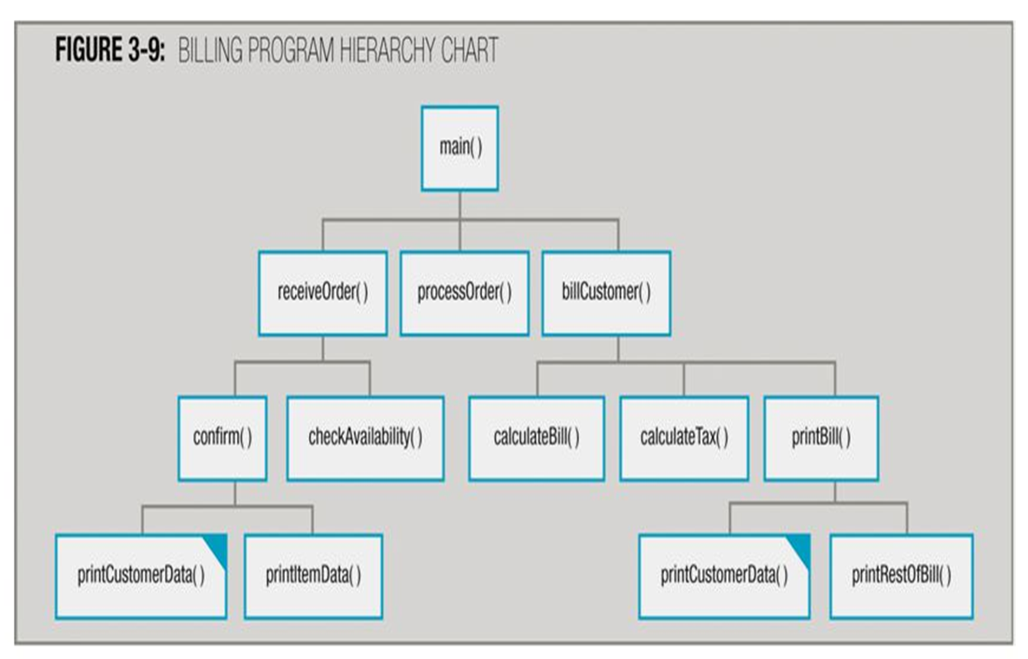
Create a hierarchy chart
Create a hierarchy chart
Run the program and configure the training game text file
Issues/problems that you spot in the game?
Notes:
Simplified development - Easier to focus on writing algorithms to small problems
- focus on code reuse avoid duplication

Slide 7
Tasks
Completed tasks
Tasks in progress
Task not started yet
1 Checking to see if you're off the board - If the player enters over 9 or under 0 it will crash the game.
2 Add a feature which tells the player the type of warship they hit.
3 No error checking for erroneous inputs - if a string is entered the program crashes!
4 Save Game File - The player is unable to save an unfinished game.
5 How would the game be extended to use a bigger board?
6 How could the game be changed to add another ship?
7 Game crashes at the main menu if a string is entered or if the menu option does not exist.
8 On menu you can enter any number. But it crashes when you enter a letter.
9 Limit the number of moves for the player to use.
10 No score is given (tell user how many moves they took to win).
11 Crashes if no input on column or row: (possibly use a try catch statement).
12 Add multiple ships of the same type in one game.

Slide 8
Tasks
Completed tasks
Tasks in progress
Task not started yet
13 Validate Position of Shot
14 Add a multiplayer option (another person or the computer).
15 Add a message for destroying warships (can be coded in a similar way to CheckWin (Board)).
16 Bonus special missile when you sink a ship (such as one with a larger range). (unnecessary)
17 Could ask for leaderboard. (very unlikely)
18 Randomize ship positions
Allow the player to fire a salvo (i.e. simultaneously enter coordinates for three shots and then
make the move)
20 Don't subtract a move when a coordinate has been re-entered.
21 Allow user to enter their own ships on the board
22 Load Text File
23 Allow diagonal placement of ships
24 Allow user to enter two-digit co-ordinates, so 35 instead of 3 then 5
25 If a miss, scan one element near the miss to see if a ship is present
26 Performing Run-length Encoding on the 'Board', possibly useful when saving the game.

